Slide 1
Apriori Algorithm in Association Rule Learning

Slide 2
What is Apriori Algorithm?
Apriori Algorithm is one of the algorithm used for transaction data in Association Rule Learning. It allows us to mine the frequent itemset in order to generate association rule between them. Example: list of items purchased by customers, details of website which are frequently visited etc.

Slide 3
This algorithm was introduced by Agrawal and Srikant in 1994.
Principles behind Apriori Algorithm
Subset of frequent itemset are frequent itemset.
Superset of infrequent itemset are infrequent itemset.

Slide 4
Apriori Algorithm has three parts: 1. Support 2. Confidence 3. Lift

Slide 5
Support( I )= ( Number of transactions containing item I ) / ( Total number of transactions )
Confidence( I1 -> I2 ) = ( Number of transactions containing I1 and I2 ) / ( Number of transactions containing I1 )
Lift( I1 -> I2 ) = ( Confidence( I1 -> I2 ) / ( Support(I2) )

Slide 6
Algorithm in a nutshell 1. Set a minimum support and confidence. 2. Take all the subset present in the transactions which have higher support than minimum support. 3. Take all the rules of these subsets which have higher confidence than minimum confidence. 4. Sort the rules by decreasing lift.

Slide 7
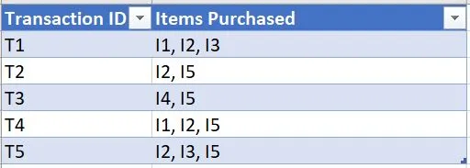
Mathematical Approach to Apriori Algorithm
Consider the transaction dataset of a store where each transaction contains the list of items purchased by the customers. Our goal is to find frequent set of items that are purchased by the customers and generate the association rules for them.
We are assuming that minimum support count is 2 and minimum confidence is 50%.

Slide 8
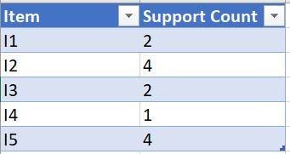
Step 1: Create a table which has support count of all the items present in the transaction database
We will compare each item’s support count with the minimum support count we have set.
If the support count is less than minimum support count then we will remove those items

Slide 9
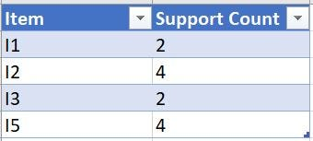
Support count of I4 < minimum support count.

Slide 10
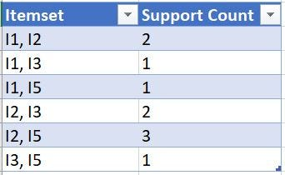
Step 2: Find all the superset with 2 items of all the items present in the last step. Check all the subset of an itemset which are frequent or not and remove the infrequent ones. ( For example subset of { I2, I4 } are { I2 } and { I4 }but since I4 is not found as frequent in previous step so we will not consider it ).
Since I4 was discarded in previous one, so we are not taking any superset having I4

Slide 11
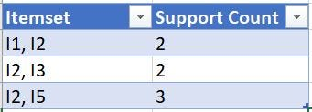
Now, remove all those itemset which has support count less than minimum support count. So, the final dataset will be

Slide 12
Step 3: Find superset with 3 items in each set present in last transaction dataset. Check all the subset of an itemset which are frequent or not and remove the infrequent ones.
In this case if we select { I1, I2, I3 } we must have all the subset that is, { I1, I2 }, { I2, I3 }, { I1, I3 }. But we don’t have { I1, I3 } in our dataset. Same is true for { I1, I3, I5 } and { I2, I3, I5 }.

Slide 13
So, we stop here as there are no frequent itemset present.
Step 4: As we have discovered all the frequent itemset. We will generate strong association rule. For that we have to calculate the confidence of each rule.
All the possible association rules can be, 1. I1 -> I2 2. I2 -> I3 3. I2 -> I5 4. I2 -> I1 5. I3 -> I2 6. I5 -> I2

Slide 14
So, Confidence( I1 -> I2 ) = SupportCount ( I1 U I2 ) / SupportCount( I1 ) = (2 / 2) * 100 % = 100%.
Similarly we will calculate the confidence for each rule.

Slide 15
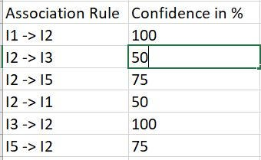

Slide 16
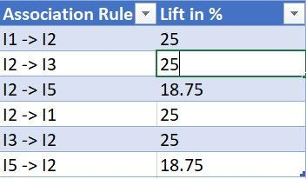
Since, All these association rules has confidence ≥50% then all can be considered as strong association rules.
Step 5: We will calculate lift for all the strong association rules.
Lift ( I1 -> I2 ) = Confidence( I1 -> I2 )/ Support( I2 ) = 100 / 4 = 25 %.

Slide 17
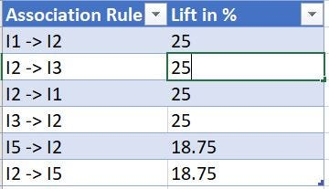
Now we will sort the Lift in decreasing order.

Slide 18
https://www.kaggle.com/datasets/puneetbhaya/online-retail/

Slide 19
import numpy as np
import pandas as pd
from mlxtend.frequent_patterns import apriori, association_rules
# Loading the Data
data = pd.read_excel('Online_Retail.xlsx')
data.head()

Slide 20
# Exploring the columns of the data
data.columns
# Exploring the different regions of transactions
data.Country.unique()

Slide 21
# Stripping extra spaces in the description
data['Description'] = data['Description'].str.strip()
# Dropping the rows without any invoice number
data.dropna(axis = 0, subset =['InvoiceNo'], inplace = True)
data['InvoiceNo'] = data['InvoiceNo'].astype('str')
# Dropping all transactions which were done on credit
data = data[~data['InvoiceNo'].str.contains('C')]

Slide 22
# Transactions done in France
basket_France = (data[data['Country'] =="France"]
.groupby(['InvoiceNo', 'Description'])['Quantity']
.sum().unstack().reset_index().fillna(0)
.set_index('InvoiceNo'))
# Transactions done in the United Kingdom
basket_UK = (data[data['Country'] =="United Kingdom"]
.groupby(['InvoiceNo', 'Description'])['Quantity']
.sum().unstack().reset_index().fillna(0)
.set_index('InvoiceNo'))

Slide 23
# Transactions done in Portugal
basket_Por = (data[data['Country'] =="Portugal"]
.groupby(['InvoiceNo', 'Description'])['Quantity']
.sum().unstack().reset_index().fillna(0)
.set_index('InvoiceNo'))
basket_Sweden = (data[data['Country'] =="Sweden"]
.groupby(['InvoiceNo', 'Description'])['Quantity']
.sum().unstack().reset_index().fillna(0)
.set_index('InvoiceNo'))

Slide 24
# Defining the hot encoding function to make the data suitable
# for the concerned libraries
def hot_encode(x):
if(x<= 0):
return 0
if(x>= 1):
return 1
# Encoding the datasets
basket_encoded = basket_France.applymap(hot_encode)
basket_France = basket_encoded

Slide 25
basket_encoded = basket_UK.applymap(hot_encode)
basket_UK = basket_encoded
basket_encoded = basket_Por.applymap(hot_encode)
basket_Por = basket_encoded
basket_encoded = basket_Sweden.applymap(hot_encode)
basket_Sweden = basket_encoded

Slide 26
# Building the model
frq_items = apriori(basket_France, min_support = 0.05, use_colnames = True)
# Collecting the inferred rules in a dataframe
rules = association_rules(frq_items, metric ="lift", min_threshold = 1)
rules = rules.sort_values(['confidence', 'lift'], ascending =[False, False])
print(rules.head())

Slide 27
frq_items = apriori(basket_UK, min_support = 0.01, use_colnames = True)
rules = association_rules(frq_items, metric ="lift", min_threshold = 1)
rules = rules.sort_values(['confidence', 'lift'], ascending =[False, False])
print(rules.head())

Slide 28
frq_items = apriori(basket_Por, min_support = 0.05, use_colnames = True)
rules = association_rules(frq_items, metric ="lift", min_threshold = 1)
rules = rules.sort_values(['confidence', 'lift'], ascending =[False, False])
print(rules.head())

Slide 29
frq_items = apriori(basket_Sweden, min_support = 0.05, use_colnames = True)
rules = association_rules(frq_items, metric ="lift", min_threshold = 1)
rules = rules.sort_values(['confidence', 'lift'], ascending =[False, False])
print(rules.head())

